Slide 1

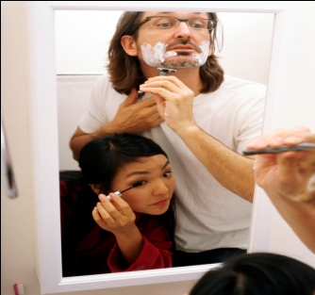
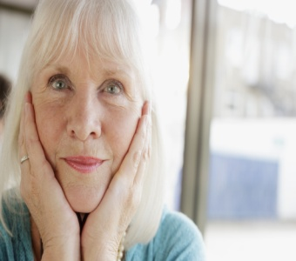
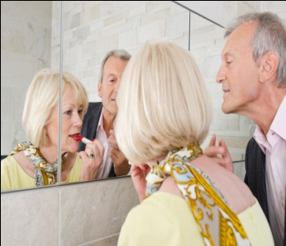
4
Unit 2 Section A
The confusing pursuit of beauty
FOREIGH LANGUAGE TEACHING AND RESEARCH PRESS
AIR FORCE ENGINEERING UNIVERTISY
Notes:
1

Slide 2
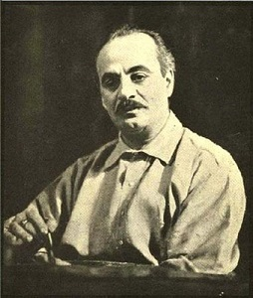
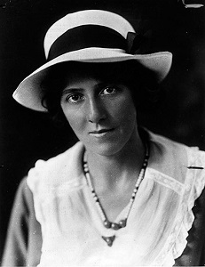
4
2
Secrets to beauty
UNIT
Beauty is not in the face; beauty is a light in the heart.
— Kahlil Gibran
You can take no credit for beauty at sixteen. But if you are beautiful at sixty, it will be your soul’s own doing.
— Marie Stopes
Notes:
2

Slide 3

^{Section A}
4
2
Secrets to beauty
UNIT
The confusing pursuit of beauty
To talk about people’s pursuit of beauty
Objectives
To fully understand the text
To apply the phrases and patterns
To master the skill of writing a comparison / contrast essay

Slide 4





A
The confusing pursuit of beauty
Section
Contents
Warming-up Activities
Text Study
Language Application
Summary

Slide 5
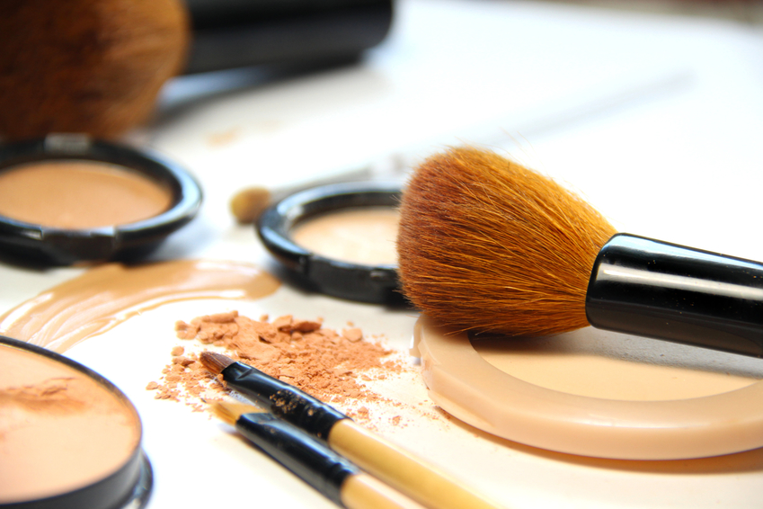


A
The confusing pursuit of beauty
Section
Warming-up Activities
Lead-in
Pre-reading Activities
Cultural Background

Slide 6
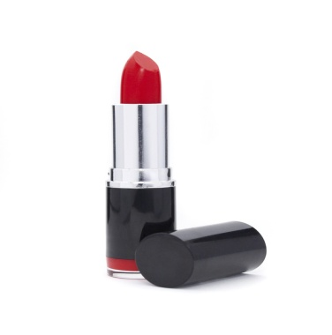
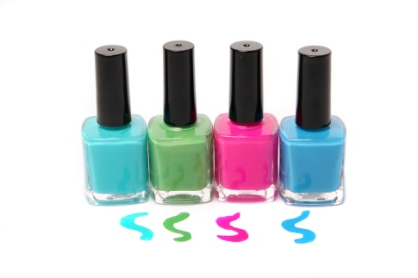
Lead-in
Short Answer Questions
What are these products in the following pictures
used for?
Lipstick is used to apply color to the lips.
(a)
Nail polish is applied to fingernails or toenails to decorate and / or protect the nails.
(b)

Slide 7
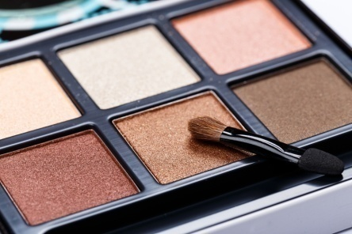
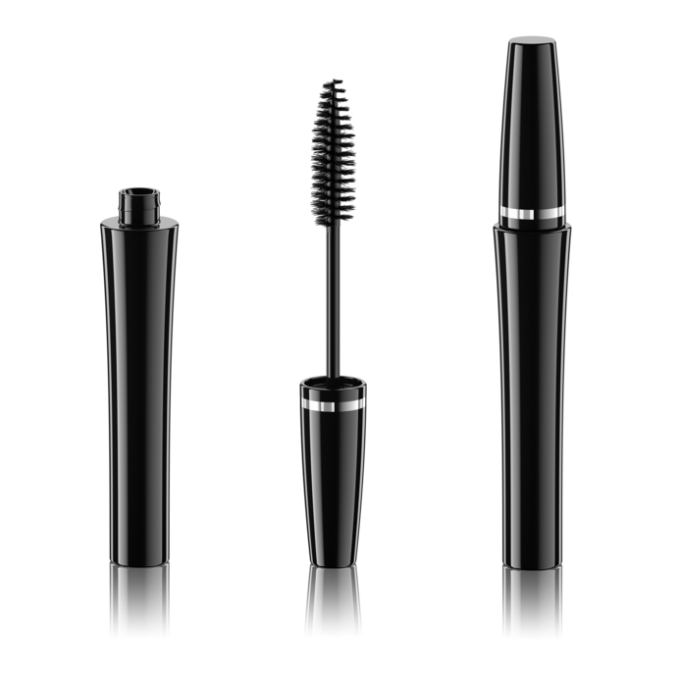
Lead-in
Short Answer Questions
What are these products in the following pictures
used for?
Eye shadow is applied to areas around the eyes, usually on the eyelids and under the eyebrows,
to make the eyes stand out or look more attractive.
(c)
Mascara is used to enhance the eyes. It may help make the eyelashes darker, thicker and longer.
(d)

Slide 8
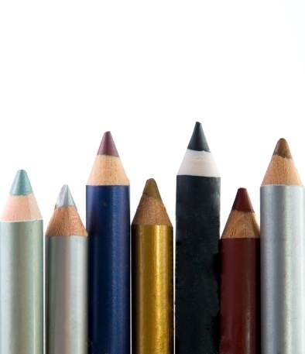

Lead-in
Short Answer Questions
1. What are these products in the following pictures used for?
Eyeliner is used to draw lines around the eyes so as to create
a more beautiful contour.
(e)
Powder foundation is used to tone the face and give it an even, uniform color. It can cover flaws, and some can also protect the face from damage caused by sunlight.
(f)

Slide 9

Lead-in
Short Answer Questions
2. Are beauty products used by women only? What do men usually do with their physical looks?
Tips
• Yes, they are generally used by women. What men usually do may be just shaving and having a haircut.
• No, I don’t think only women use cosmetics. Although men in general do not use such products in daily life, it is possible that male actors and singers wear some makeup when they perform.

Slide 10
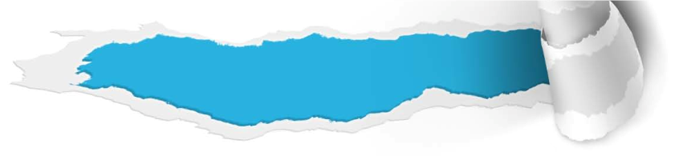
Pre-reading Activities
Appreciate and Talk
Appreciate the following sayings about beauty and then talk about your own understanding of beauty.
Beauty outside catches the eyes but the real beauty that lies within captures the heart.
External beauty disappears as you age but internal beauty is remembered even when you are long gone from this earth.
Tips

Slide 11
Pre-reading Activities
Appreciate and Talk
Tips
Beauty is the combination of all the qualities of a person or thing that delight the senses and please the mind. Physical beauty in the present society really plays a very important role for people. However, there is no everlasting beautiful appearance because of the power of magician of time. Even though cosmetics do contribute to delay the arrival of aging, appearance of youth will disappear just like flower fades away. The real beauty is reflected in one’s soul, not solely in appearance.

Slide 12



Listen to a short passage concerning the power of beauty.
One of the most successful, influential and beloved women in American history, Eleanor Roosevelt once said that she had one regret: she wished she had been prettier. Who hasn’t felt the same way? We are all too ______ of our physical imperfections. To overcome them, we spend billions upon billions of dollars every year on cosmetics, diet products, fashion, and plastic _______.
aware
surgery
To be continued

Slide 13
Listen to a short passage concerning the power of beauty.
Why do we care so much about how we look? Because it _______. Because beauty is powerful. Because even when we learn to value people mostly for being kind and wise and funny, we are still moved by beauty. No matter how much we ____________ it or pretend to be immune, beauty ______ its power over us. There is simply no escape.
matters
argue against
exerts
To be continued

Slide 14
Listen to a short passage concerning the power of beauty.
Our _________ to physical beauty is not something we can control _____ . We are born with it. Experiments conducted by psychologist Judith J. Langlois showed that even small infants prefer to look at attractive faces. Before they have met a single supermodel, before they have watched a single TV show, before they have opened up a single fashion magazine, they are drawn to the same faces which adults have ______ to be attractive.
sensitivity
at will
judged
To be continued

Slide 15
Listen to a short passage concerning the power of beauty.
There are more important things in life than beauty. But as Etcoff says, “We have to understand beauty, or we will always be ________ by it.” If you aim to be wise and kind and funny, it doesn’t mean that you can’t also try your best to look beautiful. There’s no reason to __________________ being moved by beauty’s power. It moves us all.
enslaved
feel guilty about

Slide 16

Cultural Background
Questions Previewing
1. What is Buzz-Off?
Tips
2. Who is Oprah? What is she best-known for?
Tips

Slide 17

Cultural Background
Buzz-Off
1. What is Buzz-Off?
It is a fictional character from a popular animation series called He-Man and the Master of the Universe ( 《超级宇宙战士》) , produced by the American company Filmation in 1983. It is a bee with the appearance of a human and comes from a race of Bee people.

Slide 18

Cultural Background
Oprah
2. Who is Oprah? What is she best-known for?
Tips
Oprah is an American media talk show hostess, actress, producer and philanthropist. She has been ranked the richest African-American of the 20th century and the greatest black philanthropist in American history. She is best known for her self-titled talk show known as The Oprah Winfrey Show. The show has become the highest-rated program of its kind in history and won many awards.

Slide 19


A
The confusing pursuit of beauty
Section
Text Study
Main Idea & Structure
Language Focus
Critical Thinking

Slide 20


What is the easiest way out when a man is asked by a woman to comment on her looks? And why? (Para. 2)
Tips
Form an honest yet sensitive response, then promptly excuse himself for some kind of emergency because it is very hard for the man to answer the question correctly.

Slide 21

Part I — (Paras. 1- __)
2
This part is the introduction. It tells the readers that it is very hard for a man to answer when a woman asks him how she looks.

Slide 22
Do men and women perceive their own looks in the same way? (Para. 3)
Tips
No. Men do not think of their looks in the same way women do.

Slide 23
Men’s attitude
Women’s attitude
Men stick to an opinion and like to think of themselves as average-looking. (Paras. 3-4)
Women tend to think their appearance is “not good enough”. (Para. 5)

Slide 24
Why do men and women view their looks so differently? (Para. 6)
Tips
Because of many complex psychological and societal factors.

Slide 25
Childhood experience with toys
Factor 1
Girls’ dolls have slim figures whose physical measurements are impossible
for living human beings to achieve.
Girls’
Boys’
Boys’ toys are weird-looking.

Slide 26
Influence of the beauty industry
Factor 2
The beauty industry convinces women that they must buy the newest beauty products and apply them carefully. (Para. 7)
Women
Men are not influenced by the beauty industry; they don’t face the societal focus purely on physical beauty. (Para. 8)
Men

Slide 27
What are the differences between men and women in care for details in women’s appearance? (Paras. 9-10)
Tips
Men take no notice of the details in women’s appearance. (Para. 9)
Women spend great efforts on details of appearance only to expose themselves to criticisms by other women. (Para. 10)

Slide 28
Part II — (Paras. 3- ___)
10
This part is the body of the essay, in which men and women are contrasted on three points.
• Firstly, it concerns how the two sexes
________ their own looks.
• Secondly, it focuses on the ____________
and ________ factors that cause the
differences in the way men and women view
their own appearances.
• Finally, it talks about the different degree of
attention women and men pay to the extra
______ of women’s appearance.
perceive
psychological
societal
details

Slide 29
What conclusion does the author draw after contrasting men and women on different points ? (Para. 11)
Tips
There is no easy way for a man to answer a woman’s question of how she looks.

Slide 30
Part III — (Para. 11)
This part is the conclusion, which restates the author’s view that there is no easy way for a man to answer a woman’s question of how she looks.

Slide 31
Main Idea & Structure
Main Idea of the Text
This text is a contrast essay. To find out why it is difficult for a man to answer when a woman asks him how she looks, the author discusses the differences between men and women. The author organizes the supporting details by using the point-by-point method. The specific “points” or criteria of contrast are how the two sexes perceive their own looks, what factors cause this difference, as well as how much care they pay to the details of appearance.

Slide 32

Introduction
When a woman asks a man how she looks, it is very hard for the man to answer. (Paras. 1-2)

Slide 33
Introduction
Main body: contrast between men and women on three points
Supporting view 1
Men do not think of their looks in the same way as women do.
Supporting view 2
Supporting view 3
The differences between how women and men view their own looks are caused by complex
psychological and societal factors.
Differences in care for details in women’s appearance.

Slide 34
Introduction
Main body
Conclusion
There is no easy way for a man to answer a woman’s question of how she looks. (Para. 11)

Slide 35
Introduction
Main body
Conclusion

Slide 36

The confusing pursuit of beauty
When a woman asks a man how she looks, it is very difficult for him to ___________ the right answer.
Men do not think of their looks in the same way as women do. They ________ an opinion and like to think of themselves as average-looking. They don’t __________________ to their looks. However, women tend to think their appearance is “not good enough”. They would _______ the smallest imperfections in their bodies.
come up with
stick to
affix much value to
magnify
To be continued

Slide 37
The differences between how men and women view their own looks are caused by complex ____________ and societal factors. First, men and women have different childhood experiences with toys. Girls’ dolls have slim figures whose physical measurements are _________ for living human beings to achieve while boys’ toys are weird-looking. Second, beauty industry exerts different influences on them. Women are _________ that they must buy the newest beauty products and _____ them carefully,
psychological
impossible
convinced
apply
To be continued

Slide 38
whereas men are not influenced; they don’t face the societal _____ purely on physical beauty. Men and women also have differences in care for details in women’s appearance. Men _________________ the details, but women spend great efforts on details of appearance only to _______ themselves to criticisms by other women.
Anyway, to get back to my _______ point: There is no easy way for a man to answer a woman’s question of how she looks.
focus
take no notice of
expose
original

Slide 39

Practical Phrases | Specific Meanings
1. affix value to | 认为…有价值
2. live up to | 不辜负；符合
3. complete with | 包括，连同，齐备的
4. adhere to | 遵守；拥护；坚信
5. in hopes of | 怀有…的希望
6. reach out to | 请求…的帮助
7. become/be obsessed with | （变得）对…迷恋
8. voice an opinion on | 表达对…的看法

Slide 40

认为…有价值
短语逆译
affix value to
短语应用
如果你真正想要吸引顾客，你就必须十分重视自己店里所卖产品的质量。
意群提示
(attract/ affix great value to)
If you really want to attract customers, you need to affix great value to the quality of the products sold in your store.

Slide 41
不辜负；符合
短语逆译
live up to
短语应用
如果你想毕业，就必须达到大学设定的最低标准。
意群提示
(live up to/ minimum standards)
If you want to graduate, you must live up to the minimum standards set by the university.

Slide 42
包括，连同，齐备的
短语逆译
complete with
短语应用
新建的校园十分现代，包括一个室内游泳池以及楼顶上的跑道。
意群提示
(complete with/ a running track)
The newly-built school campus is very modern, complete with an indoor swimming pool and a running track on the roof.

Slide 43
遵守；拥护；坚信
短语逆译
adhere to
短语应用
作为一名忠诚的高级官员，他始终坚守自己的行为准则。
意群提示
(senior official /adhere to / principle of conduct)
As a devoted senior official, he always adheres to his principle of conduct.

Slide 44
怀有…的希望
短语逆译
in hopes of
短语应用
埋在废墟下的受害者通过敲击发出一些声响，希望能够引起救援人员的注意。
意群提示
(be buried / ruins / in hopes of / attract one’s attention)
The victim buried under the ruins made some sound by knocking in hopes of attracting the rescuer’s attention.

Slide 45
请求…的帮助
短语逆译
reach out to
短语应用
有时,我们需要学会向他人求助,特别是当我们遭遇巨大挑战时。
意群提示
(reach out to / encounter / challenge)
Sometimes, we need to learn to reach out to others, especially when we encounter big challenges.

Slide 46
become / be obsessed with
（变得）对…迷恋
短语逆译
短语应用
很难相信，这群成年人竟然对玩具赛车如此着迷。
意群提示
(racing toy cars /be obsessed with)
It’s hard to believe that these grown men are so obsessed with racing toy cars.

Slide 47
表达对…的看法
短语逆译
voice an opinion on
短语应用
会上，每个人都要发表自己对公司前景的看法。
意群提示
(voice one’s opinion on/ prospect)
At the meeting, everyone was required to voice his opinion on the prospect of the company.

Slide 48

Functional Patterns | Functions & Usages
1. no amount of sth. will do … | 用于表达“无论如何都不会发生期待的结果”。
2. sth. happens, especially when… | 用于表达“事物的普遍性或严重性”。
3. I’m not saying that … I’m just saying that… | 用于更正“某人真实的想 法”。
4. Anyway, to get back to my original point:… | 用于表达“言归正传”。
Notes:
48

Slide 49
原句译文
对于她的这一问题，无论你事先练习多少次，都不会找到正确答案。
逆译练习
No amount of rehearsal will help you come up with the right answer.
句型提炼
Notes:
49

Slide 50

句型提炼
No amount of sth. will do …
应用提示
用于表达“无论如何都不会发生期待的结果”。
句型应用
Notes:
50

Slide 51
典型例句
他十分固执，无论怎么说，都不会使他改变心意。
意群提示
(stubborn / no amount of words)
He is very stubborn and no amount of words will make him change his mind.

Slide 52
原句译文
要达到这样的标准是很荒唐的，尤其是当我们想想那种洋娃娃的腰围尺寸，就知道其相对尺寸对任何一个活人来说都是不可企及的。
逆译练习
This is an absurd standard to live up to, especially when you consider the size of the doll’s waist, a relative measurement physically impossible for a living human to achieve.
句型提炼
Notes:
52

Slide 53
句型提炼
Sth. happens, especially when…
应用提示
用于表达“事物的普遍性或严重性”。
句型应用
Notes:
53

Slide 54
典型例句
出国留学会是一次艰难的经历，特别是当你不得不离开所爱的人，独自面对全新的环境。
意群提示
(study abroad/ beloved ones)
Studying abroad can be a difficult experience, especially when you have to leave your beloved ones and face the new environment all alone.

Slide 55
原句译文
我并不是说男性优于女性。我的意思是你不可能让一群中年男子在布拉德· 皮特的指导下把化妆品敷到自己脸上，期望自己能看起来更像布拉德。
逆译练习
I’m not saying that men are superior. I’m just saying that you’re not going to get a group of middle-aged men to plaster cosmetics to themselves under the instruction of Brad Pitt in hopes of looking more like him.
句型提炼
Notes:
55

Slide 56
句型提炼
I’m not saying that…. I’m just saying that.…
应用提示
用于更正“某人真实的想法”。
句型应用
Notes:
56

Slide 57
典型例句
我不是说外貌不重要；我的意思是内在美在大多数情况下更加珍贵。
意群提示
(be of no importance / inner beauty/ valuable)
I’m not saying that appearance is of no importance. I’m just saying that inner beauty, under most conditions, is more valuable.

Slide 58
原句译文
不管怎样，言归正传：如果你是一位男性，当有女士问你她看起来怎么样时，你千万不能说她看起来很糟糕，那样肯定会使她立刻迁怒于你，这也是你咎由自取。
逆译练习
Anyway, to get back to my original point: If you’re a man, and a woman asks you how she looks, you can’t say she looks bad without receiving immediate and well-deserved outrage.
句型提炼
Notes:
58

Slide 59
句型提炼
Anyway, to get back to my original point:…
应用提示
用于表达“言归正传”。
句型应用
Notes:
59

Slide 60
典型例句
不管怎样，言归正传：父母不应给孩子太多物质的东西而宠坏孩子。
意群提示
(shower sb. with sth. /material things/ spoil)
Anyway, to get back my original point: Parents should not spoil their children by showering them with too many material things.

Slide 61



一位女士，无论她看起来多么吸引人，她对自己的看法总是由于受美容业的影响而蒙着一层阴影。
a. No matter how attractive a woman may be, her perception of herself is eclipsed by the beauty industry. (Para. 5, L2)

Slide 62
她把身体上的极小的不完美之处加以放大，并且幻想这些缺点十分明显，以至于全世界的人都会注意到并且嘲笑她。
b. She magnifies the smallest imperfections in her body and imagines them as glaring flaws the whole world will notice and ridicule. (Para. 5, L4)

Slide 63
尽管如此，产值达几十亿美元的美容业，在超市化妆品销售专区的配合下，总是在不停地攻击着女性的自尊，使其相信自己只有购买最新的保湿面霜、古铜散粉，以及各种美容器具，才能“激发和恢复”肌肤活力。
c. Nonetheless, the multibillion-dollar beauty industry, complete with its own aisle in the grocery store, is devoted to constant warfare on female self-esteem, convincing women that they must buy all the newest moisturizing creams, bronzing powders and appliances that promise to “stimulate and restore” their skin. (Para. 7, L2)

Slide 64
女性参与这种极端的从众行为，实际上是把自己置于其他女性的审视之下，因为只有那些女性才有资格评价她们所付出的努力。
d. By participating in this system of extreme conformity, women are actually opening themselves up to the scrutiny of other women, the only ones qualified to judge their efforts. (Para. 10, L1)

Slide 65
但是，你也不能慷慨地大放空洞之词，赞美她
的鞋子和裙子是多么相配，因为她知道你是在说谎。
e. But you also can’t shower her with empty compliments about how her shoes complement her dress nicely because she’ll know you’re lying. (Para. 11, L3)

Slide 66




What are the factors that make women pay much greater attention to their appearance than men do?
Tips
2. Are there any occasions in life where it is
necessary for a person, either a woman or
a man, to look good? Why or why not?
Tips
What do you consider as the most important
traits that make a person beautiful?
Tips

Slide 67

What are the factors that make women pay much
greater attention to their appearance than men do?
I think there are three main factors.
The first are cultural traditions. It is common in many cultures that people put high value on beauty when they look at women.
The second is the requirement of certain jobs. For example, China airline companies set certain criteria for appearance when they recruit stewards and stewardesses.
Finally, the influence of the media is another strong factor which shapes women’s pursuit of physical beauty.

Slide 68
2. Are there any occasions in life where it is necessary
for a person, either a woman or a man, to look good?
Why or why not?
• Yes. On certain formal occasions, a person, either female or male, has to pay attention to his attire. Sample cases are job interviews, business meetings, weddings, and banquets. This is because to dress properly is an important element of successful completion of these events.
• No. People do not have to care what others think of them as long as they feel comfortable and satisfied with their looks themselves. After all, this is the most important source of happiness to people.

Slide 69
3. What do you consider as the most important traits
that make a person beautiful?
In my opinion, the important traits of human beauty include two types, one for appearance and one for inner qualities. Features that characterize a beautiful appearance are a good-looking body, proper clothes and accessories, as well as the use of makeup that matches the occasion or event one is attending. Inner qualities that make a person beautiful mainly include good manners and positive personality traits such as honesty, bravery or friendliness.

Slide 70

Q: Cosmetic surgery is becoming increasingly popular among young people in both eastern and western societies. Can you analyze the reasons behind that?
There are various reasons why people opt for cosmetic surgery.
External factors:
Avoidance of ethnic prejudice; fear of age discrimination; pressure from working environment,etc.
Internal factors:
A strong desire to diminish unpleasant feelings related to looks; to alter a specific feature that does not meet one’s own expectation; a crazy pursuit for long-lasting youth; being competitive in career advancement, etc.

Slide 71




Watch a video clip and discuss the following questions.
Q1: What do most people think of their appearances according to the video?
Tips
Q2: What message do you get from the video clip?
Tips
Video Watching

Slide 72
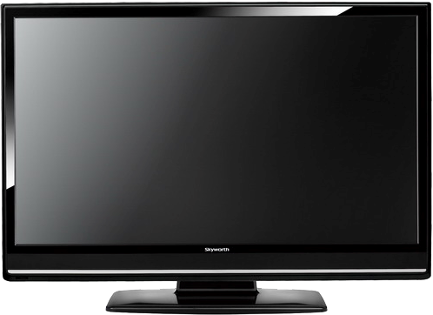

Back

Slide 73

How do most people perceive their appearances
according to the video?
• They are not satisfied with their looks.
• They focus more on the imperfections of their
physical appearances.
• They think they are less pretty than they really are.

Slide 74
2. What message do you get from the video clip?
We are more beautiful than we thought we should be. Therefore, we should spend more time appreciating the things we do like instead of wasting time trying to fix the imperfections of our physical appearance.

Slide 75

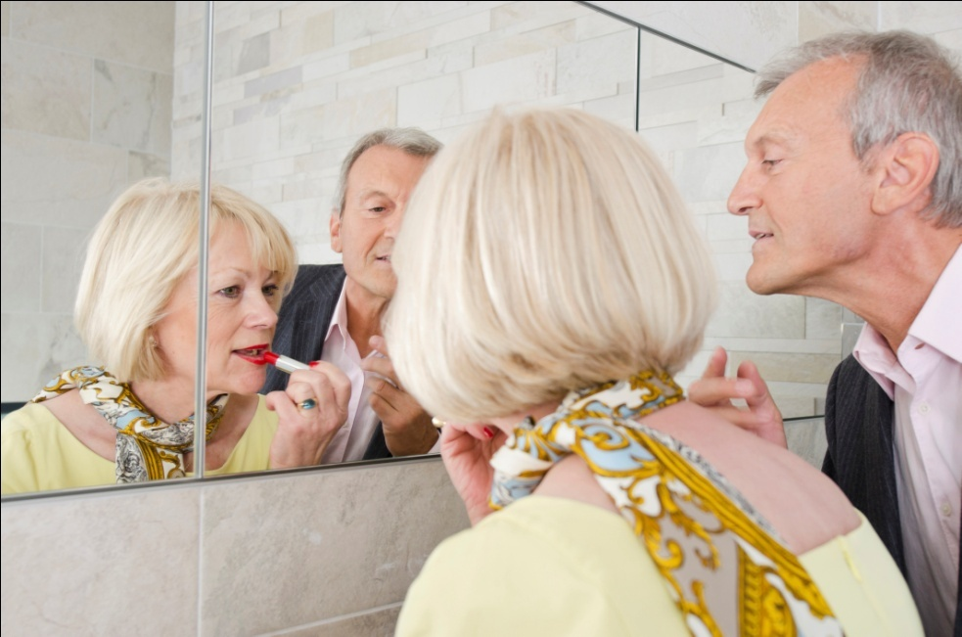
A
The confusing pursuit of beauty
Section
Language Application
Writing Devices
Oral Reproduction
Paragraph Translation

Slide 76

Write a comparison / contrast essay
A comparison / contrast essay is an essay in which two things are compared or contrasted. In a comparison essay, the author shows how two things are similar; in a contrast essay, the author discusses how two things are different. There are two basic methods to organize the body of a comparison / contrast essay. One is the “point-by-point” or “alternating” method. The other is the “subject-by-subject” pattern, also referred to as the “side-by-side” or the “block” pattern.
to be continued

Slide 77
With “point-by-point” style, supporting details are presented according to the “points,” namely the criteria of comparison / contrast. The author first talks about how two subjects are similar or different with respect to one point, and then he moves to the next point to do the same. The process will be repeated until all points are finished.
In the format of “subject-by-subject”, the author fully explains one subject by presenting all its points or characteristics. He then proceeds to do the same for the other subject.
to be continued

Slide 78

Let’s look at two outlines of an essay that discusses whether domestic cosmetics or foreign cosmetics are better. They show the two patterns respectively.

Slide 79
Point by point
Introduction:
To buy domestic cosmetics is a better choice in view of affordability and the time of distribution to stores.
Body:
1 Affordability (Price)
(a) Domestic cosmetics: less expensive, easily affordable
(b) Foreign cosmetics: more expensive
2 Time span between production and purchase
(a) Domestic cosmetics: less time needed for being
delivered to stores for sale
(b) Foreign cosmetics: more time needed for distribution because of importing procedures
Conclusion: Domestic cosmetics enjoy unique advantages over imported products.
to be continued

Slide 80
Side by side
Introduction:
To buy domestic cosmetics is a better choice in view of affordability and the time of distribution to stores.
Body:
1 Domestic cosmetics
(a) Affordable prices
(b) Shorter time of storage: less time needed for being delivered to stores for sale
2 Foreign cosmetics
(a) High prices
(b) Longer time of storage: more time needed for distribution because of importing procedures
Conclusion: Domestic cosmetics enjoy unique
advantages over imported products.
to be continued

Slide 81
Read the sample essay and see how it develops with the “point-by-point” style.

Slide 82
Topic:
How are boys and girls brought up?
Introduction:
Boys and girls are brought up in quite different ways, which can be seen in the clothes they wear, the toys they play with, and the games they like.
Body:
Supporting point 1: Boys and girls grow up wearing different clothes.
• Boys wear plain and low-key colors.
• Girls wear bright and strong colors.
to be continued

Slide 83
Supporting point 2:
Boys and girls like to play with different types of toys.
• Boys tend to have toys that demonstrate power and strength.
• Girls favor toys that show feminine beauty.
Supporting point 3:
Boys and girls like to play distinct types of games.
• Boys like to play more active outdoor games.
• Girls like to play more games related to domestic activities.
Conclusion: Children are raised in approaches that vary according to their gender.
to be continued

Slide 84
Sample Essay
We know from our own life experience that men and women behave according to distinct norms. For example, women pay greater attention to their clothes than men do. In fact, gender distinctions seen in adult human beings have their origins in early childhood. Boys and girls are brought up in quite different ways, which can be seen in the clothes they wear, the toys they play with, and the games they like.
to be continued

Slide 85
Sample Essay
First of all, boys and girls grow up wearing different clothes. Boys are usually dressed in plain and low-key colors such as blue and grey. In contrast, girls’ clothes often have bright and strong colors such as red and yellow. When you go to a kids wear store, you will instantly feel this drastic difference.
to be continued

Slide 86
Sample Essay
Secondly, boys and girls play with different types of toys. Boys are bought toys that demonstrate power and strength. For example, they may get a doll in the shape of a warrior or a fast-speed toy car as a birthday gift. Girls, however, are likely to receive a doll that looks pretty and feminine, for instance a Barbie doll in beautiful clothes and accessories. In this way, boys and girls find their ideal gender images from what they play with.
to be continued

Slide 87
Sample Essay
Thirdly, boys and girls like distinct types of games. Boys tend to play more active outdoor games such as war-fighting and chasing-and-running. On the contrary, girls favor more games related to domestic activities such as cooking and babysitting. Participation in different fun activities helps develop different gender roles of men and women. For instance, males are encouraged to be strong, while females are encouraged to be gentle.
to be continued

Slide 88
Sample Essay
In conclusion, children are raised in approaches that vary according to their gender. Boys and girls are given different dresses, bought different toys and taught to play different games. Our parents’ conscious ways of developing our gender roles contribute significantly to making us what we are today.

Slide 89
Writing practice
Directions:
Write a contrast essay of no less than 200 words on one of the following topics. One topic has an outline that you can follow.

Slide 90
Topic: How do women and men groom themselves?
Introduction:
Women and men take care of their appearance in very different ways, which are mainly shown in three areas.
Body:
• The variety of beauty tools and products they use
• The amount of clothes they have
• The amount of time they spend on grooming themselves
Conclusion:
Women and men behave differently in how they attend to their routine grooming chores.

Slide 91
More topics:
• What kind of graduate education would
you choose, to study in China or overseas?
• Where would you like to work after
graduation, in a big city or in a small town?

Slide 92
Oral Reproduction
Presentation Making
Discuss with your classmates on the topic “What is Real Beauty” and then give your presentation.

Slide 93

Oral Reproduction
Presentation Making
You can follow the outline given below.
Part I. General introduction
1. What is beauty;
2. People’ pursuit of beauty.
Part II. Your understanding of physical beauty
1. Importance of physical beauty;
2. Popularity of cosmetic surgery and its
disadvantages.
To be continued

Slide 94

Oral Reproduction
Presentation Making
You can follow the outline given below.
Part III. Your understanding of inner beauty
1. Qualities of inner beauty;
2. Greater importance of inner beauty and examples;
Part IV. Conclusion
Inner beauty is more important than outer beauty.
To be continued

Slide 95

Oral Reproduction
Presentation Making
You may adopt the following expressions.
• affix value to
• in terms of aesthetics
• magnify the smallest imperfections
• complex psychological and societal factors
• stimulate and restore one’s skin
• adhere to the guidelines
• apply products via the tips of one’s fingers
• plaster cosmetics to oneself
• promote one’s self-esteem
• become obsessed with

Slide 96

Translate a paragraph based on the summary of the text by using the expressions from the text.

Slide 97
如果一名男士被一名女士要求评价她的容貌，他很难找到正确回答。男性和女性对外表的看法截然不同。男性不是特别注重自己的外貌，而女性总是认为自己的容貌“还不够好”。女性把自己外貌想得这么差的现象是由许多复杂的心理和社会因素相互作用造成的，例如：
come up with
affix value to
deficient
complex
interaction
To be continued

Slide 98
童年时期不同的玩具经历，来自美容业的不同影响。男性和女性对女性外貌的细节也有着不同的关注程度。男性不会去注意细节，而女性则费力地注重细节以取悦男性，结果却招致其他女性的指责。
beauty industry
take no notice of
appease
expose…to…
prosecution
Sample

Slide 99
If a man is asked by a woman to comment on her looks, it’s very hard for him to come up with the right answer. Men don’t think of their looks in the same way women do. They don’t affix much value to their appearance, while women always believe their looks are “not good enough”. The phenomenon that women consider their looks so deficient is caused by the interaction of many complex psychological and societal factors, such as, different childhood experiences with toys and different influences from the beauty industry. Men and women also show different care for details in women’s looks. While men take no notice of them, women work so hard to appease men only to expose themselves to prosecution from other women.

Slide 100

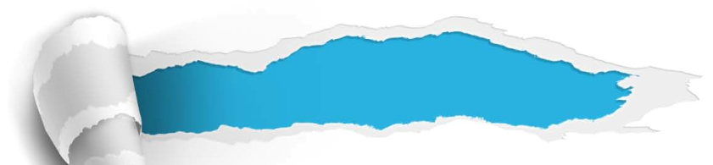

A
The confusing pursuit of beauty
Section
Summary
Revision of
the Useful Expressions
Thematic study
Revision of
the Functional Patterns

Slide 101

1 最简单的方法
2 找到正确答案
3 形成对某人自己的看法
4 对…感到自傲
5 认为…有价值
6 从美学的角度
7 因…相形见绌，黯然失色
8 不辜负；符合
9 将…与…相比
10 包括，连同
the easiest way out
come up with the right answer
form an opinion of oneself
be arrogant about
affix value to sth.
in terms of aesthetics
be eclipsed by
live up to
contrast… with…
complete with

Slide 102
11 遵守，坚信
12 在…的指导下
13 期望
14 请求…的帮助
15 提升自尊
16 变得对…迷恋
17 把自己置于审视之下
18 言归正传
19 对…大放空洞赞美之词
20 就…给出主观评价
adhere to
under the instruction of
in hopes of
reach out to
promote one’s self-esteem
become obsessed with
open oneself up to scrutiny
get back to one’s original point
shower sb. with empty compliments
voice a subjective opinion on

Slide 103

Functions & Usages | Sentence Patterns
1. 用于表达“无论如何都不 会发生期待的结果”
2. 用于表达“事物的普遍性 或严重性”
3. 用于更正“某人真实的想 法”
4. 用于表达“言归正传”
No amount of sth. will do …
Sth. happens, especially
when…
I’m not saying that…
I’m just saying that…
Anyway, to get back to my original point:…
Notes:
上面挤，下面空

Slide 104



A
The confusing pursuit of beauty
Section
The end

